Slide 1
Authentication and Permission in Function Based View in Django REST Framework

Slide 2
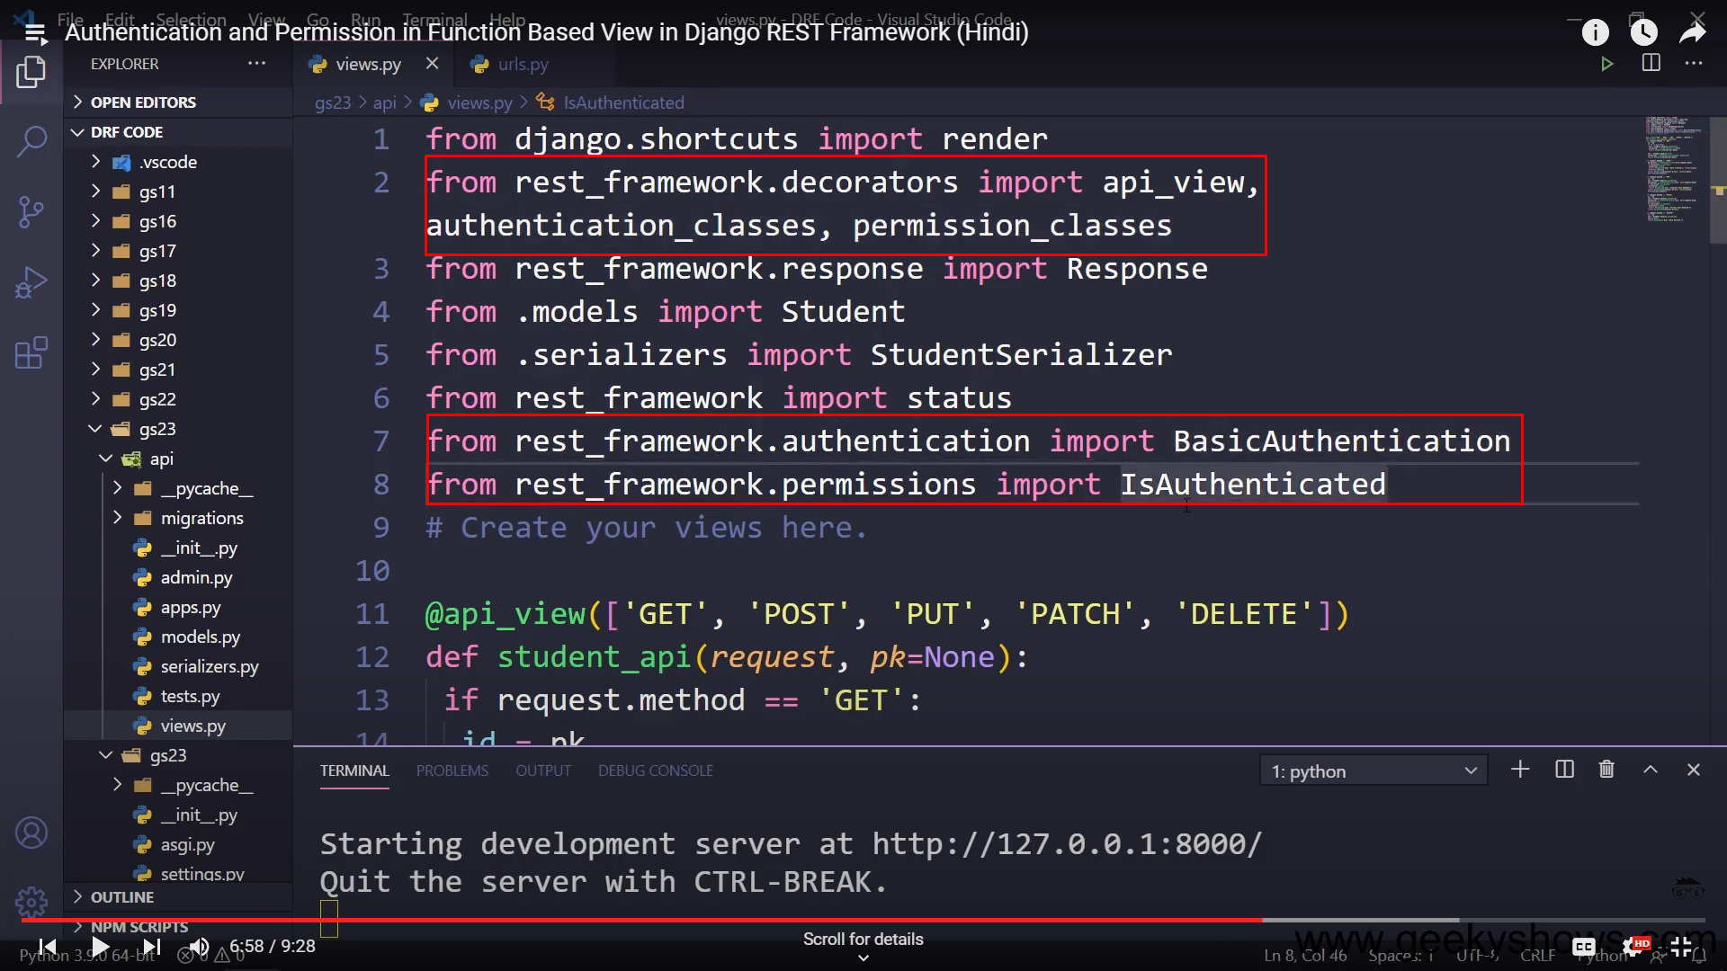
Function base view permissions and authentications

Slide 3
